Slide 1

Teamwork

Slide 2

Teamwork
“When you're part of a team, you stand up for your teammates. Your loyalty is to them. You protect them through good and bad, because they'd do the same for you.”
  - Yogi Berra

Slide 3

What is a Team?
A team is a collection of individuals, each with his/her own expertise, brought together to benefit a common goal.
Teams are often comprised of people who do not know each other and who must work hard to develop productive working relationships despite personal differences and cultural practices.

Slide 4
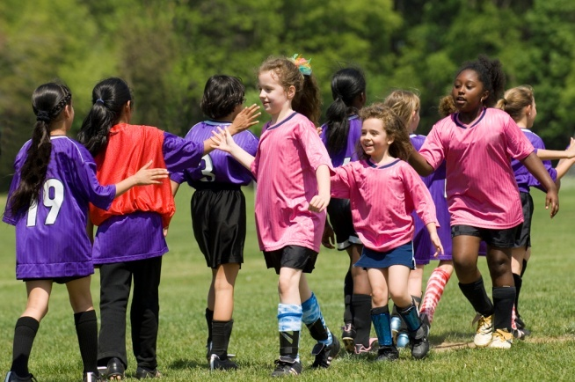
Benefits of a Team
Shared workload
Chance for leadership and personal satisfaction
Sense of belonging to a successful process
Ability to accomplish more than if work done independently

Slide 5


Developing a Team
Step #1: Have team members come together to identify the team’s mission.
What does the team have to do?
How will the team accomplish the task?
What information is needed?
What resources are available?

Slide 6
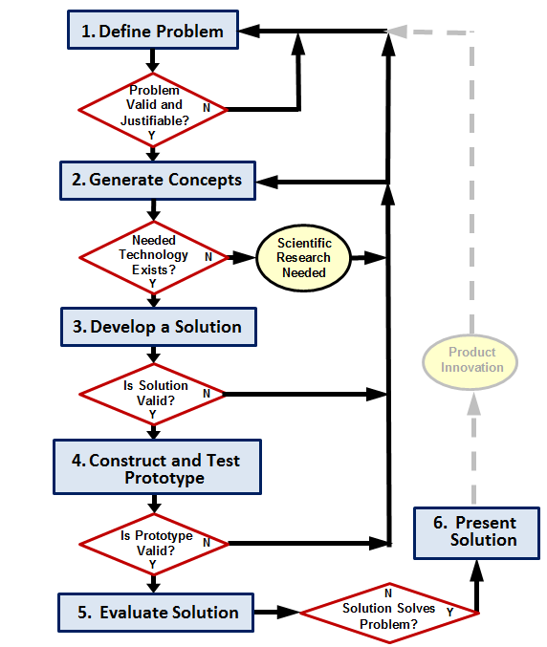
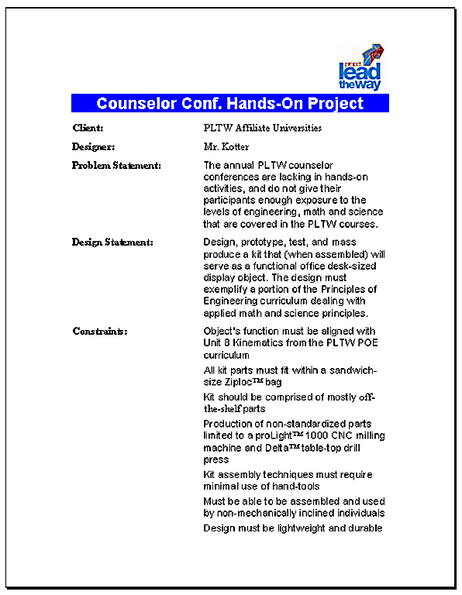
The Team’s Mission
Design Brief

Slide 7
Developing a Team
Step #2: Have team members establish group norms.
Develop guidelines or rules.
Establish them through consensus.
“No design decision will be acted on before discussion with and consensus from all the team members.”

Slide 8
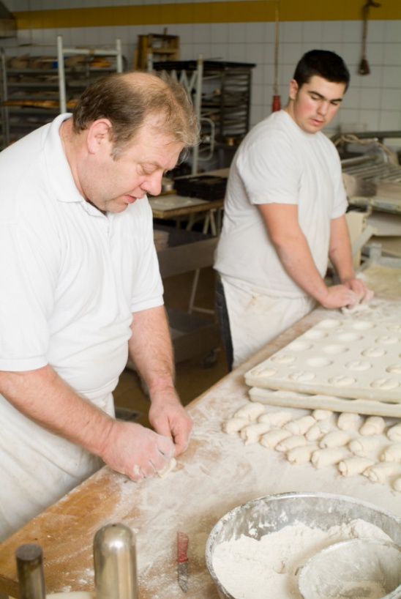
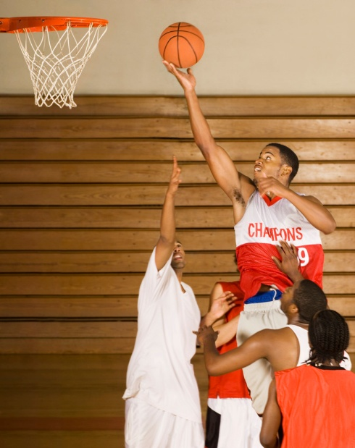
Developing a Team
Step #3: Identify team members’ strengths and weaknesses.
Have team members list their individual talents, skills, and limitations.
Identify job responsibilities.
Each team member’s strengths are a support mechanism for the other team member’s/members’ weaknesses.

