Slide 1
EXAMPLE 2
Isometric Sketch

Slide 2
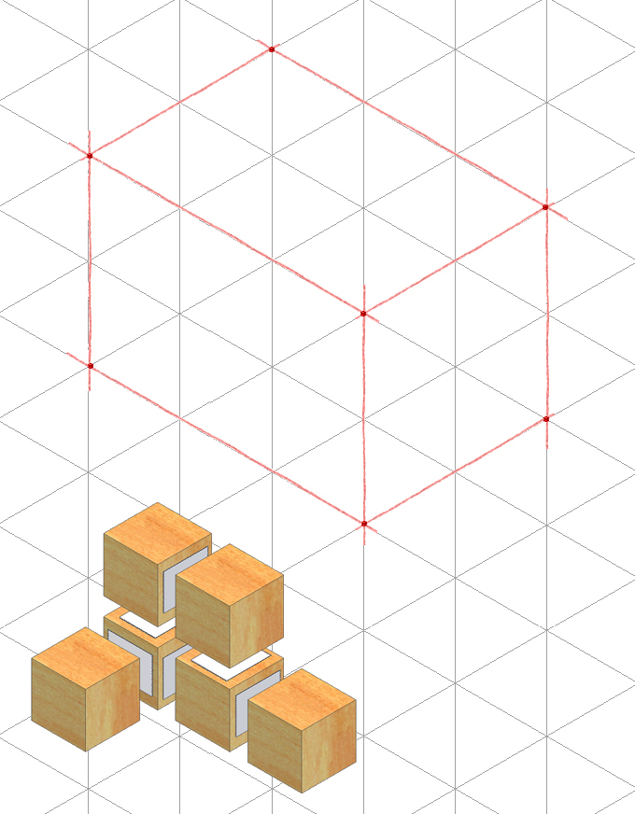
Step 2: Outside Faces
Use points and construction lines to identify corners and edges of object faces that occur on surface of the box

Slide 3
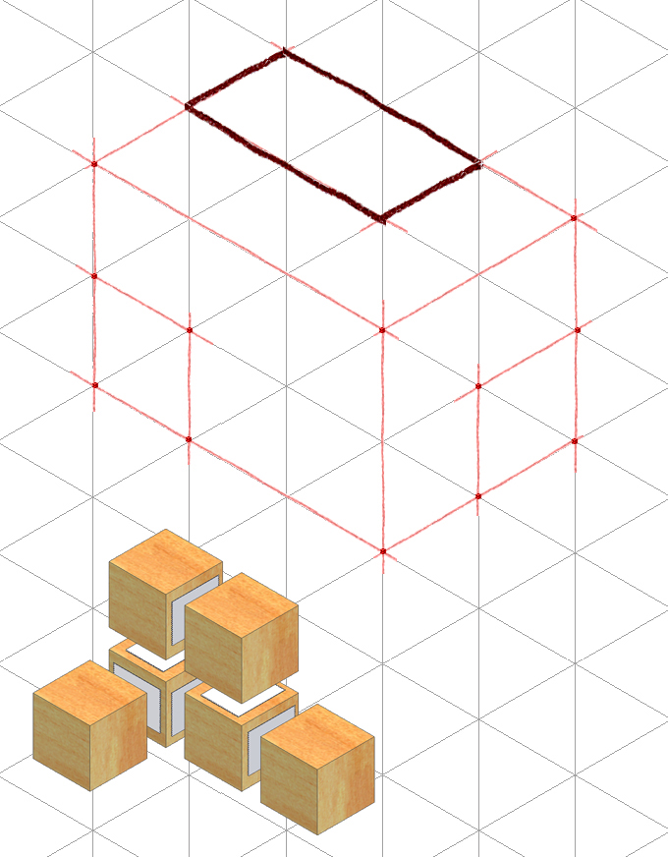
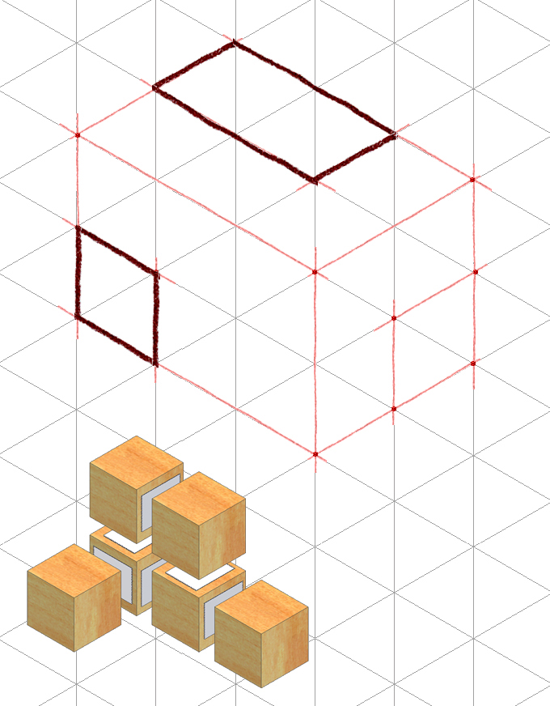
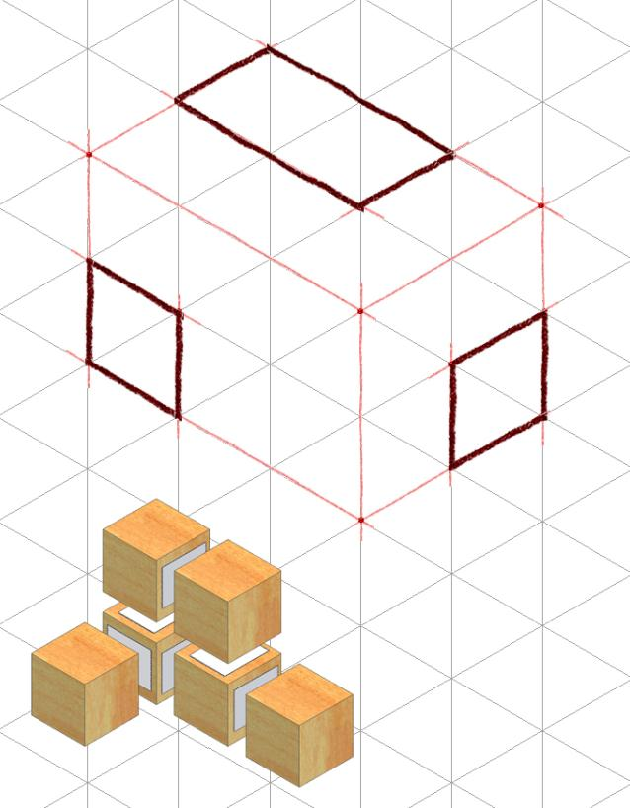
Step 2 – Outside Faces (continued)
Before sketch becomes too congested with construction lines, trace visible edges with object lines

Slide 4
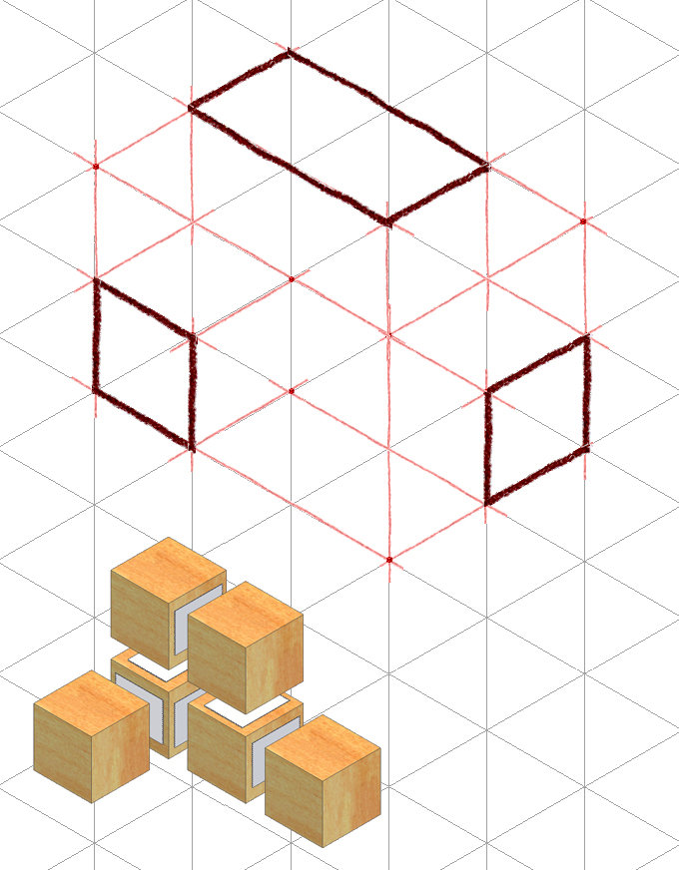
Step 3 - Inside Faces
Use points and construction lines to identify the corners and edges of the object faces that occur inside the box.

Slide 5
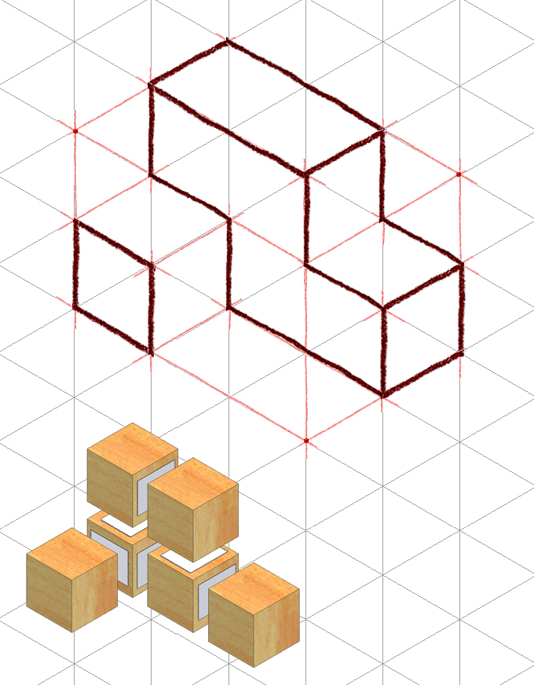
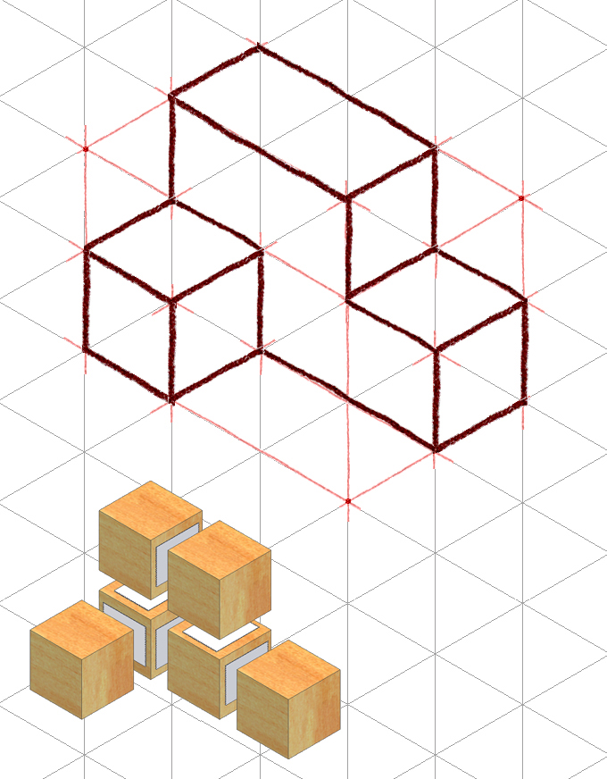
Step 3 - Inside Faces (continued)
Trace out remaining visible edges with object lines

Slide 6
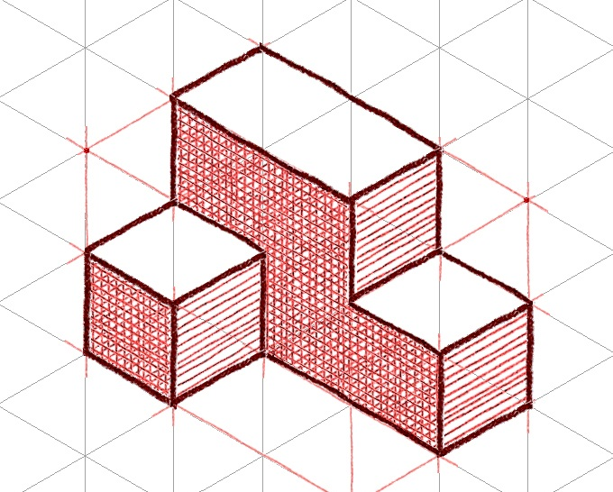
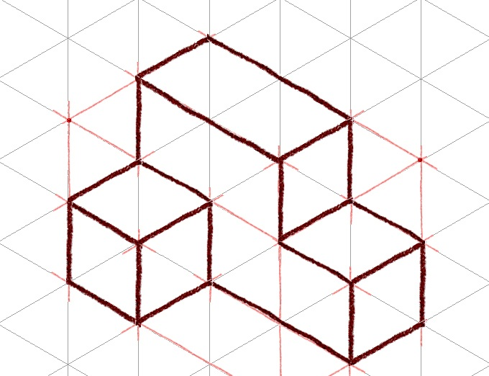
Step 4 - Tonal Shading
Decide the light source position, and add tonal shading to two of the three faces
A shading option is to use parallel lines drawn closely together on a face
Increase contrast by cross-hatching lines on darkest face
Notes:
Again, tonal shading is a technique that helps enhance the sketch and create a more realistic representation. It imitates reflections and shadows that would naturally occur when a direct light source is introduced.

Slide 7
Isometric Sketch Example

